Slide 1
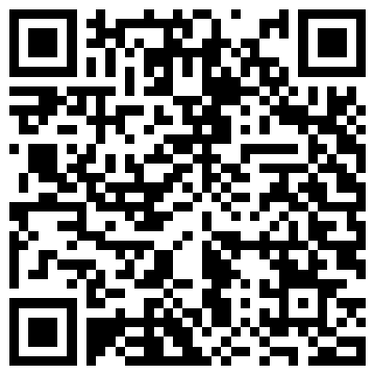
Please scan the QR code to sign-in. If you don’t have a QR code scanner, you can also use our physical sign-in sheet.

Slide 2
“Scholarship for
Service”

Slide 3
Purpose
Honor students for both academics and community service
Foster interest in improving the community!

Slide 4
Membership Qualifications:
Grades
10 hours of service hours per semester
Service hours are volunteer hours
1 CSF approved project per semester
Failure to meet service qualifications will cause your semester membership to be revoked
You must reapply each semester

Slide 5
Membership Dues:
$10 per academic year
Can be paid to the treasurer (make sure to give her your name so that we know who paid)
Do not turn in money to the CSF box
Expenses include:
Certain projects (ie. sending care/relief packages)
Graduation regalia

Slide 6
Lifetime Members
4 semesters of membership
Based on grades from 10th-12th
One semester is based on senior grades

Slide 7
Current Opportunities- School Projects
Campus Clean Up
Mentoring/Link Crew Leaders
Canned Food Drive
Valley Verde Fall Carnival- Sunday, October 30th
More at http://csfnorthgate.weebly.com/

Slide 8
Current Opportunities- Volunteer Projects
Heather Farms- Dec. 3rd and 4th
Creek Clean Up
Contra Costa Food Bank
Contra Costa Interfaith Housing
More can be found at http://csfnorthgate.weebly.com/

Slide 9
Contact Info:
Email us: northgate.csf@gmail.com
Remind: text “@csflea” to 81010
Website: csfnorthgate.weebly.com

